Slide 1
Old Technology
This presentation is about a really old technology, Windows' batch files. Does anybody use Windows' batch files?

Slide 2
Most Batch Files Are A Mess
Most batch files I've seen in the wild are pretty messy. They are often quite long and not well structured. I know this partly because I've written hundreds of them. I wrote batch files for years that were a mess. I like to think I'm a little better now.
For Example, I googled "typical batch file" and this was the first hit:
https://www.instructables.com/id/5-Cool-Batch-Files/

Slide 3
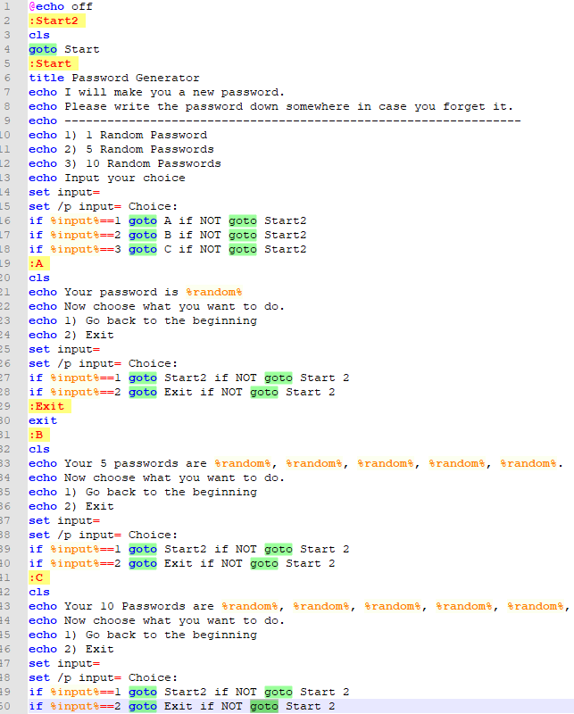

Slide 4
This small file has 19 goto statements! Makes my head hurt looking at it.
The lack of structure is a problem and leads to hard to read and understand code.

Slide 5
How to Modularize?
So let's impose some structure. In most programming languages there's a concept of a function.
At the heart of Composable Batch Files is the enforcing the use of traditional functions or code blocks.
Anatomy of a function. Here are the basic structural elements:
* [label] = function name (which must be unique)
* call :[label] = function call to another function in this batch file.
* goto [label] = also a function call, which does not return to the caller. Use judiciously.
* exit/b = end of function. The lack of exit/b is the most common culprit. Without ending
functions, you have spaghetti code.

Slide 6
A More Structured and Functionalized Approach
Building the batch file around the a set of functions can turn a normally disorganized environment into a structured and organized one.

Slide 7
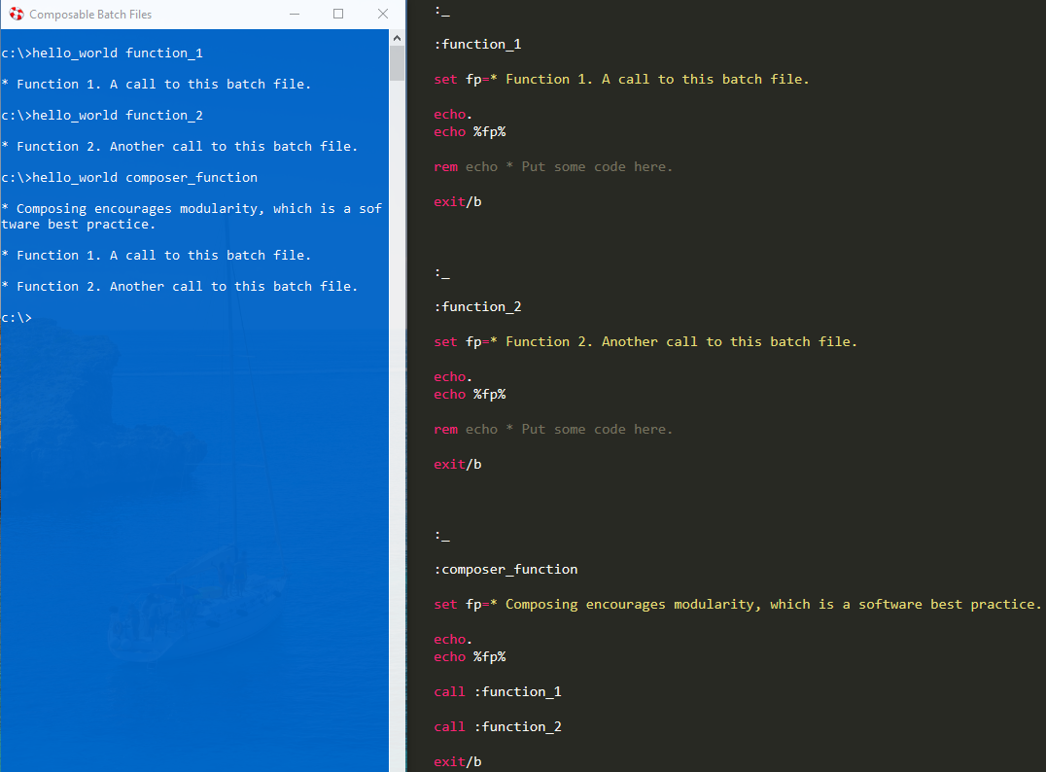
Hello World Demo

Slide 8
Setup Instructions
Add %COMPOSABLE_BATCH_FILES% as an environment variable or, at least, add it to your path to where you installed the repository.
If you so choose, also add these environment variables for the following:
* %CBF_DEFAULT_BROWSER%
* %CBF_DEFAULT_TEXT_EDITOR%
* %CBF_DEFAULT_REPOSITORY_FOLDER%

Slide 9
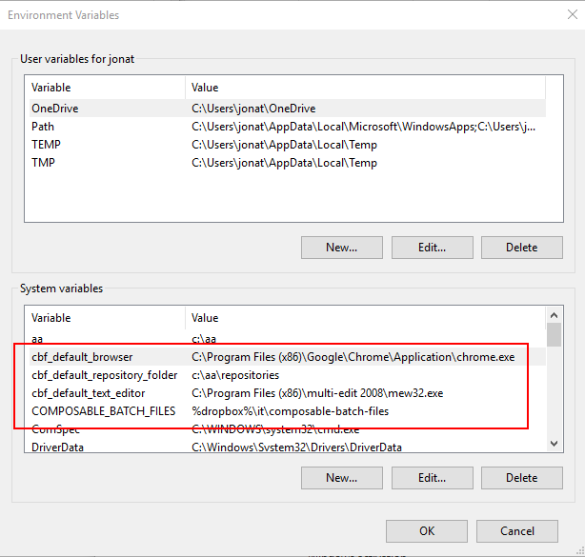
Here's an example of some CBF environment variables:

Slide 10
Done with Setup
After you have cloned or downloaded the CBF repository, double click the shortcut titled "Composable Batch Files Helper" to open up a blue command prompt.

Slide 11
Menu
All of the batch files in CBF use a functionalized, modular approach. To see a menu of all the available CBFs type "menu" or "cbf" at the prompt.

Slide 12
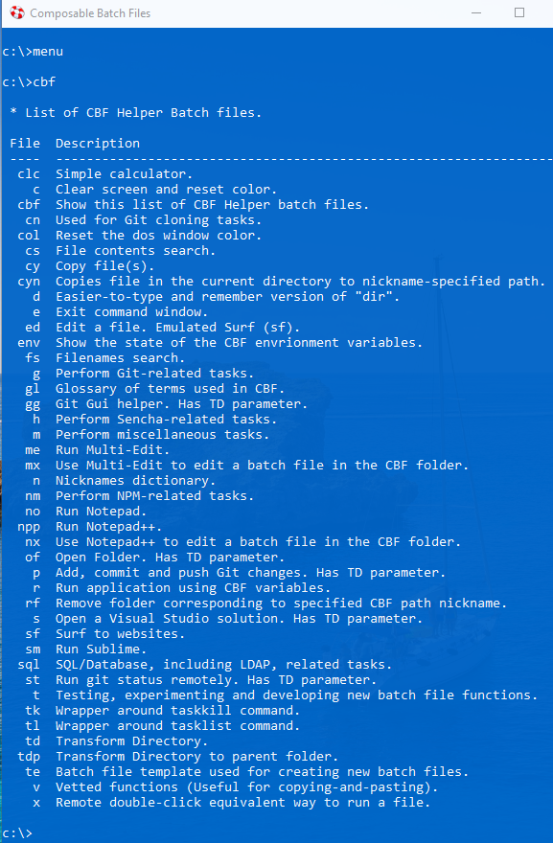

Slide 13
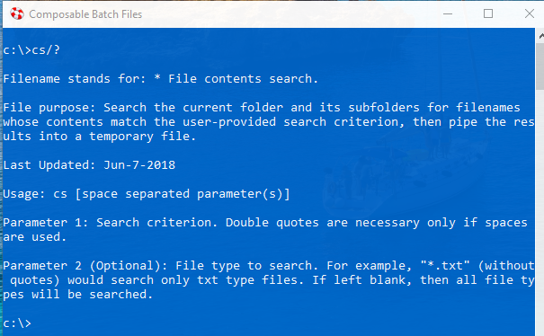
Getting Help
To get help with a particular batch file, at the prompt type "[batch file name]/?". For example:

Slide 14
Couldn’t care less? Questions?

Slide 16
Extra Credit
Run fs.bat and cs.bat to search like a boss.

Slide 17

To download and for more info., see:

